Slide 1
Narrative Journeys
A narrative structure for exploring written and visual storytelling.
WORKSHOP GUIDE

Slide 2
Descriptive
Details
Supporting Characters
Texture

Slide 3
Notes:
Replace with new layout

Slide 4
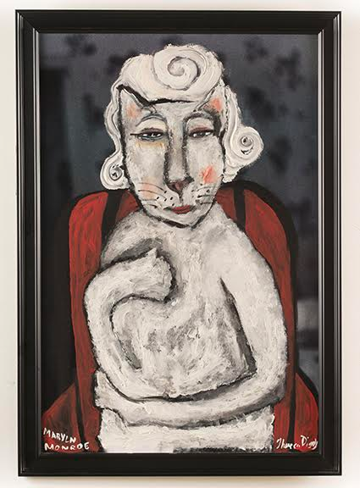
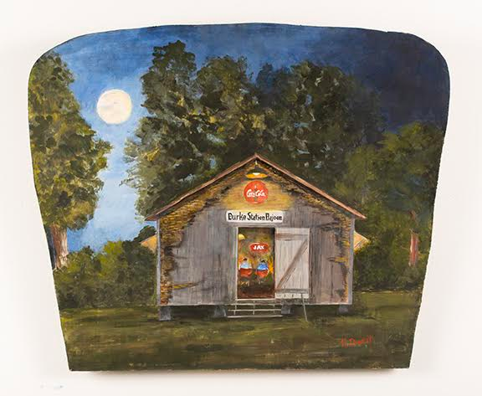
Grand-mère cat wanted
her favorite musician to play for the night,
but the full moon had someone else in mind,
so out from the dark Tune-Tabby came to play his guitar.
Setting: Monroe’s Scratchin Post
Character: Grand-mère Cat
Notes:
Replace with new layout

Slide 5
DIORAMA STRUCTURE

Slide 6
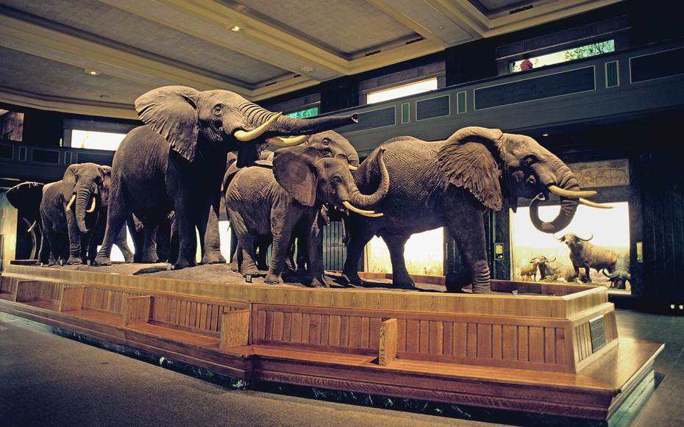
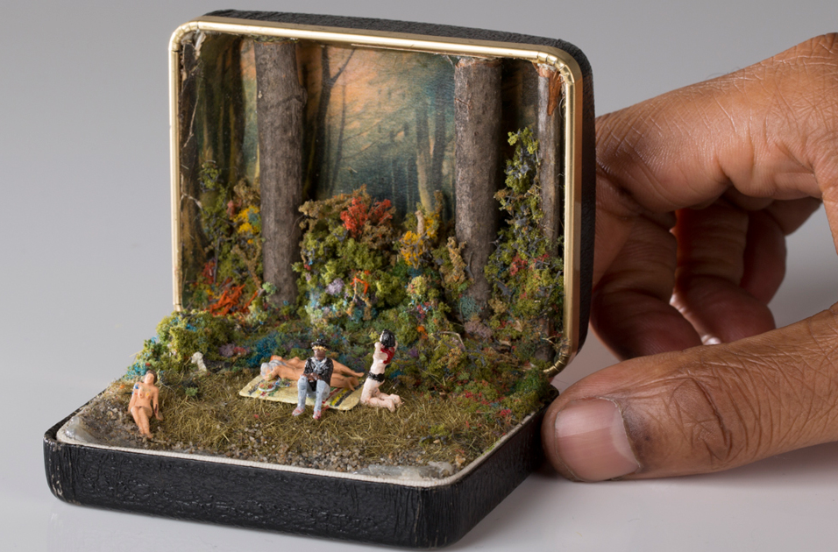
Dioramas
Dioramas have been used in many different applications; they vary in three-dimensional form and range from full-size to miniature models. They often depict a scene that captures a moment in time and is comprised of multiple objects.
Notes:
Question before moving forward:
Have any of you ever seen a diorama; either in real life or on the screen?

Slide 7
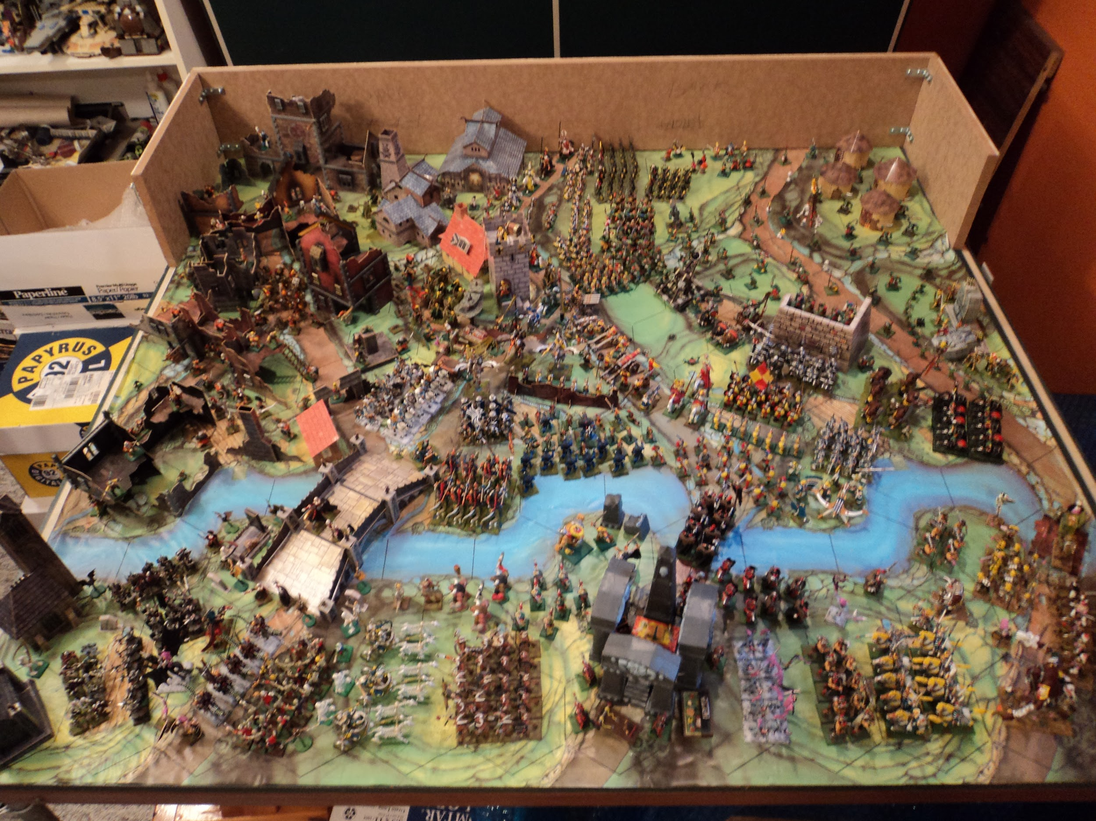
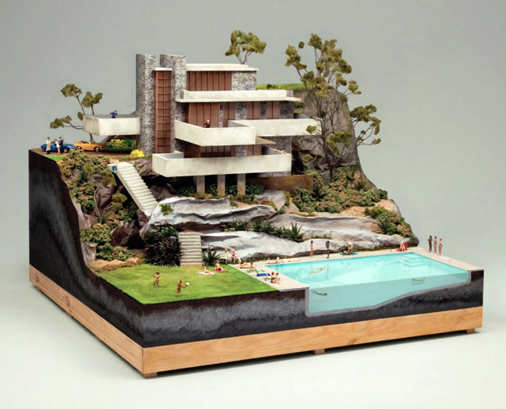
Dioramas can be seen...
On gaming tables...
In architecture offices...

Slide 8
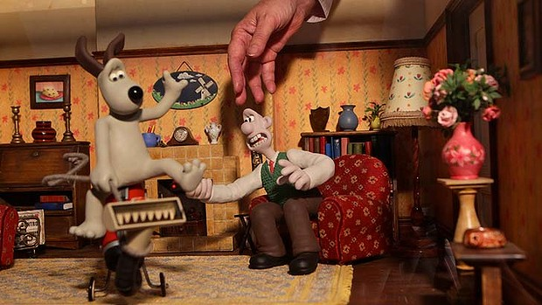
As well as in movie...

Slide 9
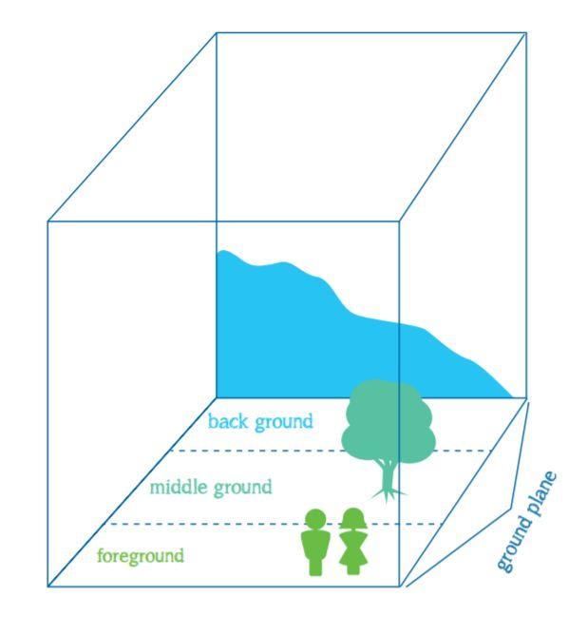
Structuring a Diorama setting:
Break your design ideas down into
Background
Middleground
foreground
Notes:
We will use a simple diorama format to build our visual “Narrative Journeys”.
**Show an example of the triangular corner structure.
*Modification for the classroom teacher- collect shoeboxes from each student.
Planning for how you will break down the back, middle and foreground can be done on the front folded edge of your hand out.
Thinking ahead to any important action that you would like to see depicted in your scene. Add it to the front fold of your hand out.
-While this project incorporates all of the elements the two we are focusing on is form and space.
-While each project will have many principles hard at work within their designs, we will be focusing on movement and pattern.
Elements:
Line
Color
value
Texture
Shape
Form
Space
Principles:
Balance
Contrast
Emphasis
Movement
Pattern
Ryythm
Unity

Slide 10
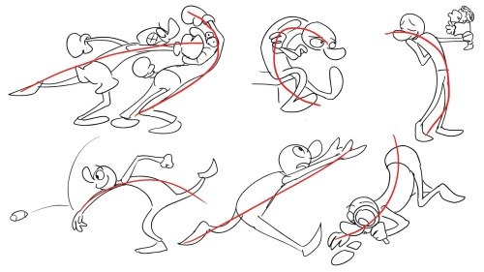
Structuring the Main Character:
Pay attention to scale and the details of your character.
What are the actions
of your character.
Notes:
Demo:
Character details and trait drawings and notes
To scale drawing of the figure
Cut out torso

Slide 11
Notes:
Demo:
Character details and trait drawings and notes
To scale drawing of the figure
Cut out torso

Slide 12
STORY STRUCTURE

